Slide 1



Library Management System

Slide 2

Introduction
This is an comprehensive explanation of the Library Management System code. It includes the structure, functionality of each section, and a user guide for available commands. The system is implemented in C and is designed to manage books, members, and borrowing transactions efficiently.
L

Slide 3

Code Overview
This is an comprehensive explanation of the Library Management System code. It includes the structure, functionality of each section, and a user guide for available commands. The system is implemented in C and is designed to manage books, members, and borrowing transactions efficiently.
Global Variables:
• book ids, book copies, book borrowed counts: Store book details like IDs, number of copies, and borrow counts.
• member ids, member borrowed counts: Store member details like IDs and the count of borrowed books.
• borrow book ids, borrow member ids, borrow dates: Store borrowing transaction details including book IDs, member IDs, and dates.
Input Procedure:
Input data is provided via the terminal in a structured format.
The input begins with book data, followed by member data, and finally borrowing transaction data. Each section is marked with a specific header.

Slide 4
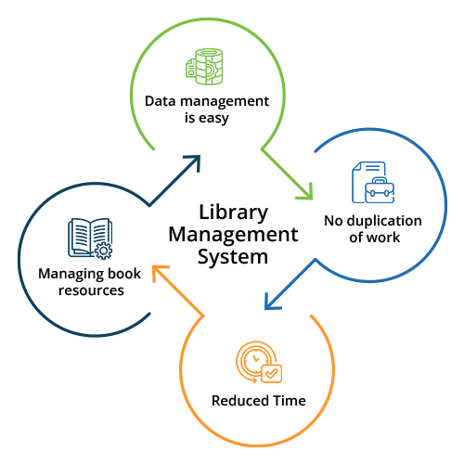
Functions and Their Purpose
The system is modular, with each function dedicated to specific tasks.
Adding Books and Members:
These functions add books and members by updating the corresponding global arrays. For example:
• add book(101, 5); adds a book with ID 101 and 5 copies.
• add member(201000); adds a member with ID 201000.
Borrowing Books: The system supports tracking book borrowing transactions. Each transaction logs the book ID, member ID, and the date of borrowing. The borrow data is stored in global arrays, which are updated every time a book is borrowed.

Slide 5


Detailed Query Commands
Number Books
Books Available
Most Borrowed
WEAKNESSES
Purpose: Displays the total number of books in the library system. Example:
• Input: Number Books
• Output: 5
Purpose: Lists all books that have copies available for borrowing.
Logic: The system checks if the total number of copies of a book exceeds the number of times it has been borrowed. Example:
• Input: Books Available
• Output: 102 103
Purpose: Identifies the book(s) with the highest borrowing count.
Logic: The system finds the maximum value in the book borrowed counts array and lists the corresponding book IDs.
Example:
• Input: Most Borrowed
• Output: 101
Pros:
- Strong Leadership
-
-
Cons:
-
Pros:
-
-
-
Cons:
-
-
-
-
PASSIONS

Slide 6


Advanced Queries
Books Borrowed Days:
Purpose: Calculates the number of unique days on which books were borrowed. Logic: The function iterates through borrow dates to count unique entries.
Example:
• Input: Books Borrowed Days • Output: 2 (Unique dates: "01/12/2024", "03/12/2024")
Overlapping Borrowers:
Purpose: Identifies members who borrowed the same book on the same day.
Logic:For each book ID in borrow book ids,the system checks if multiple borrow records have the same date.
Example:
• Input: Overlapping Borrowers 101
• Output: 201000 202000
Understand the Role
Self-Assessment
Practice Common Interview Questions

Slide 7
THANK
You
Omar Yasser
Sameer Ahmed
Kareem Ahmed
Mohamed Ayman
Kirollos Ihab
Youssef Khaled
Abdullah Abdulrhman

